Slide 1




AI for Life Sciences

Slide 2
Our mission:
customize AI solutions for life sciences
integrate Multi-modal data
2. DEVELOP interpretable ai models
3. Enhance reproducibility & scalability with pipelines
Notes:
Animate each

Slide 3
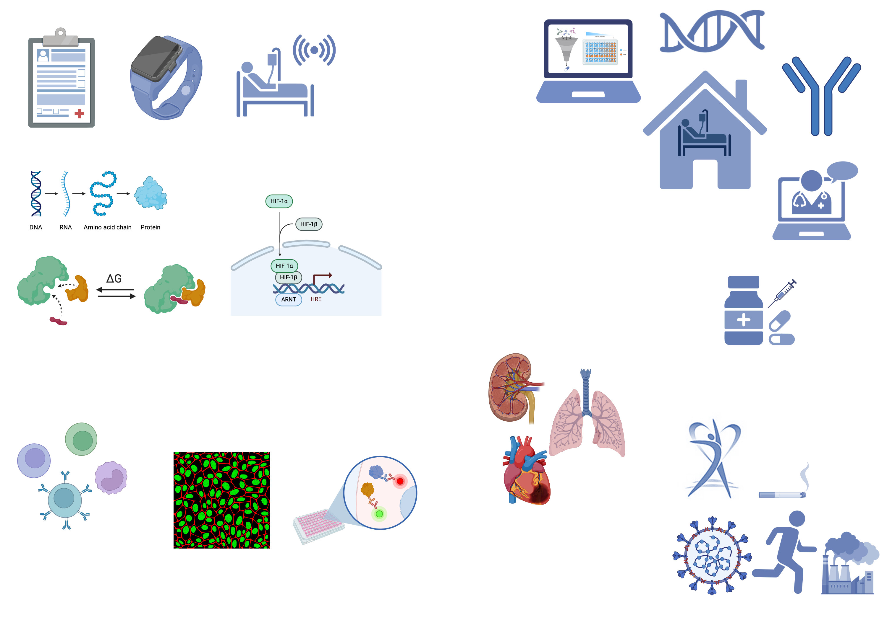
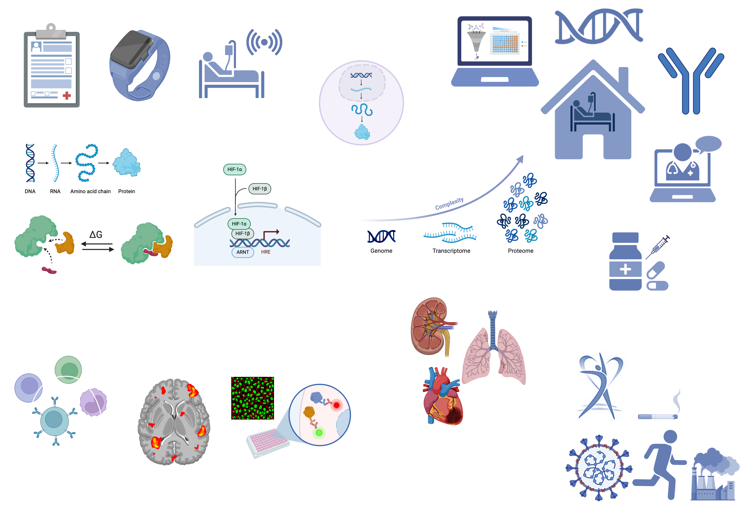

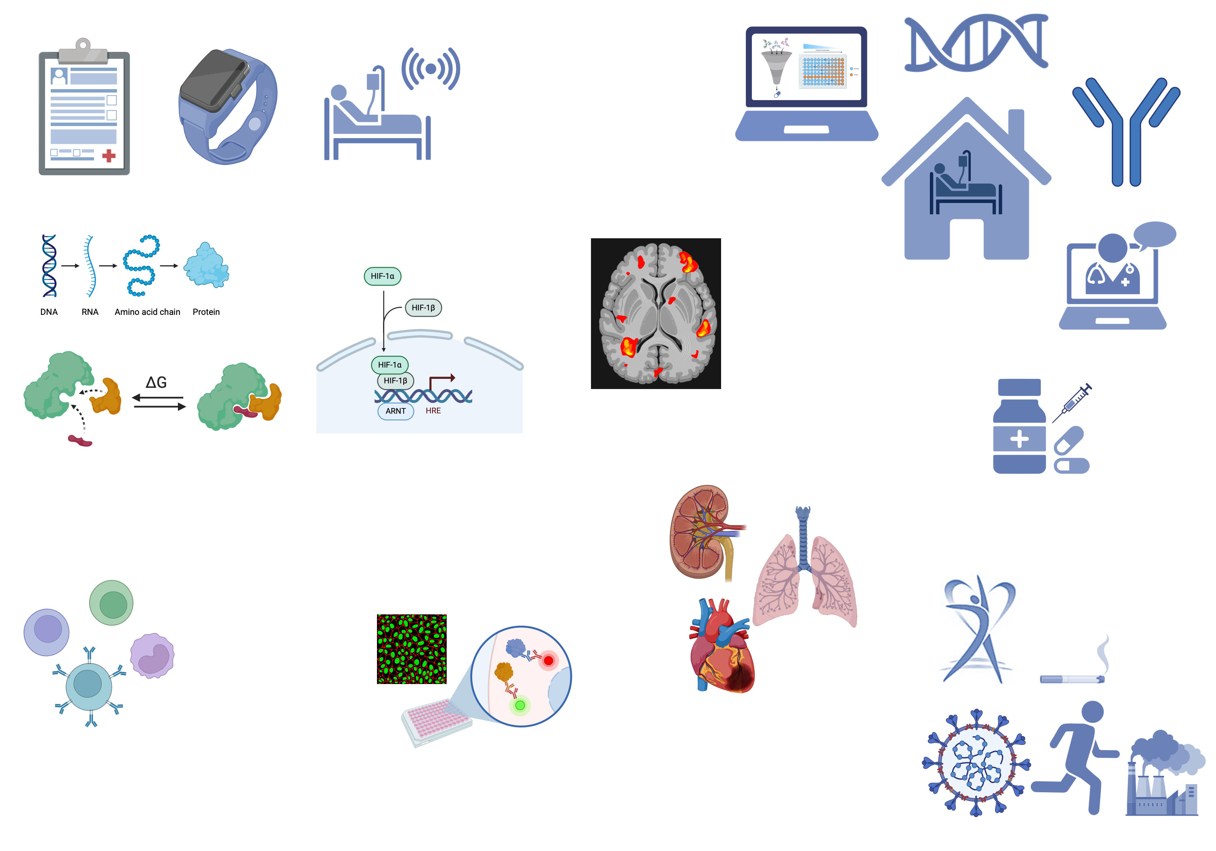
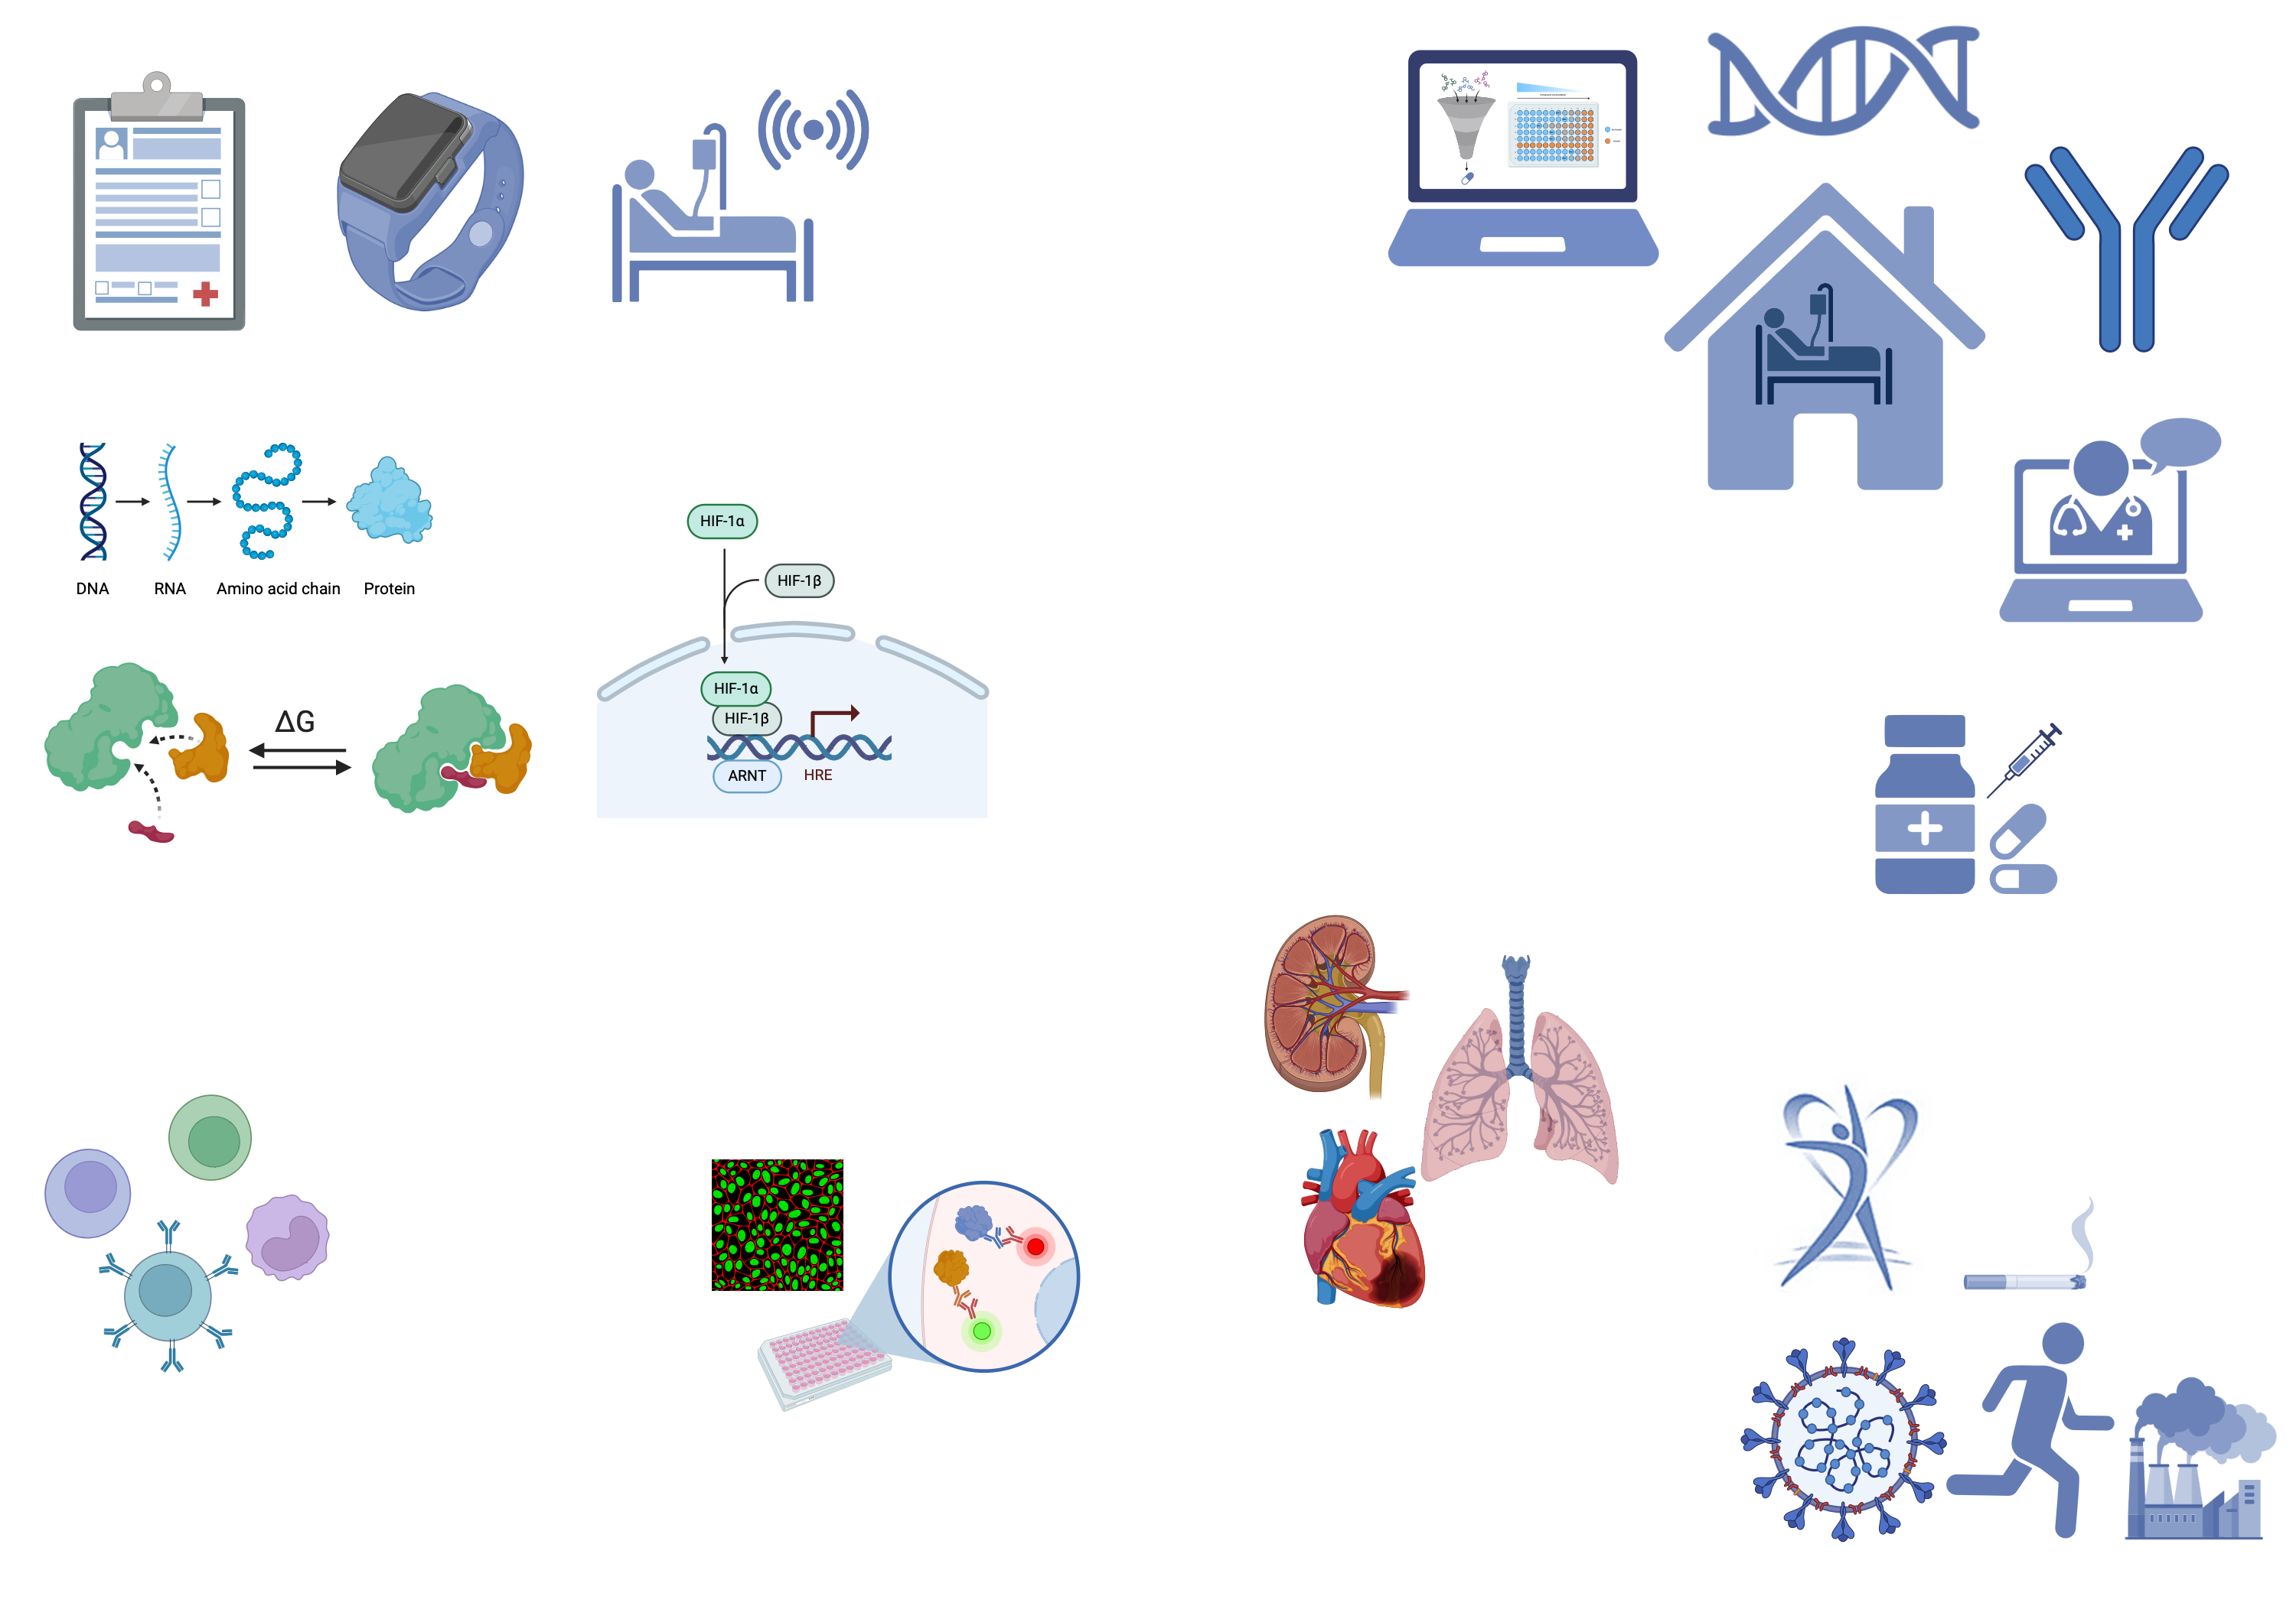
Integrate Multi-modal data
Transform
Embed
Visualize
Electronic Healthcare Records
Molecular Data
Bio-Imaging Data
Notes:
Animate each

Slide 4
2. DEVELOP interpretable ai models
Incorporate
A priori knowledge
BUILD AND TRAIN AI MODELS
PREDICT AND EXPLAIN
BIOLOGY
Biological Pathway
Notes:
Animate each

Slide 5















3. enhance reproducibility & scalability - pipelines
Tailor scalable pipelines
LEVERAGE
CUTTING-EDGE MACHINE LEARNING SOLUTIONS
HARNESS THE POWER OF CLOUD
Notes:
Animate each

Slide 6
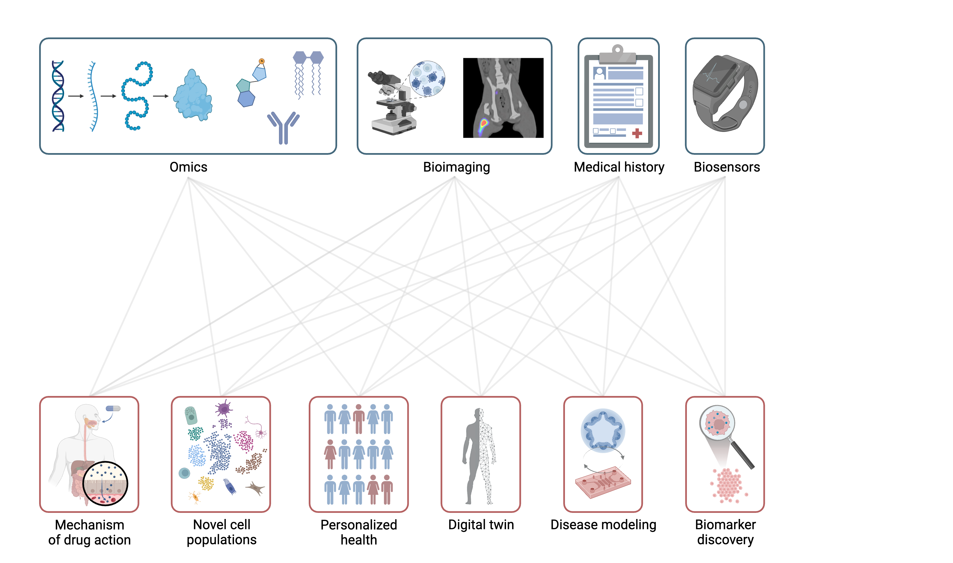
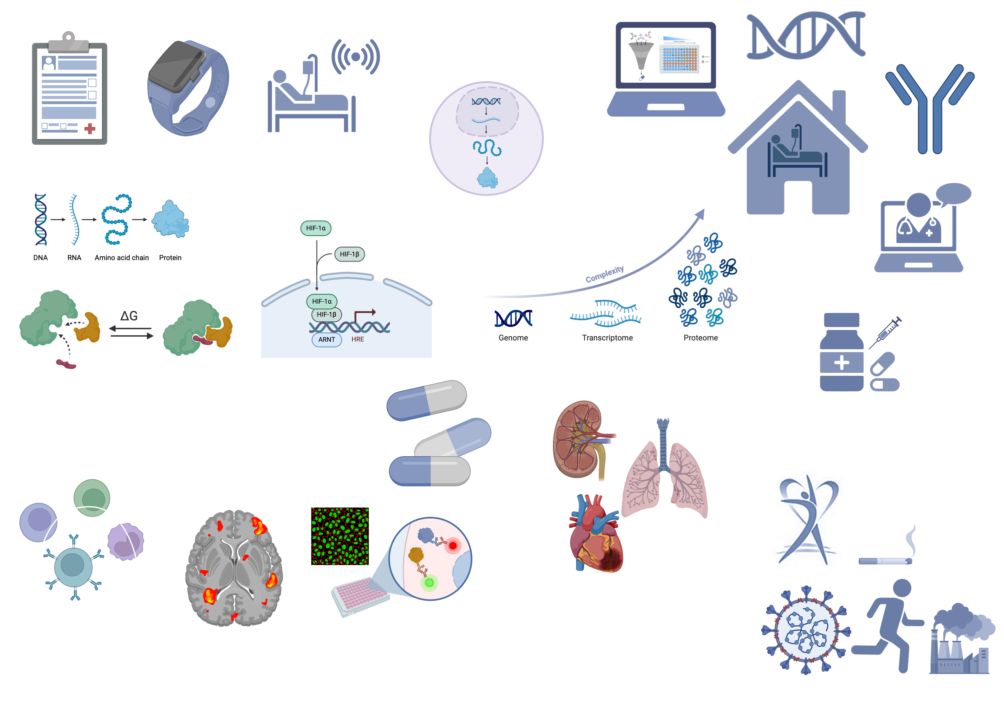
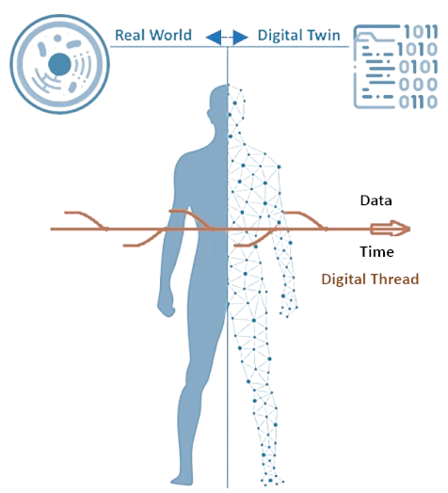
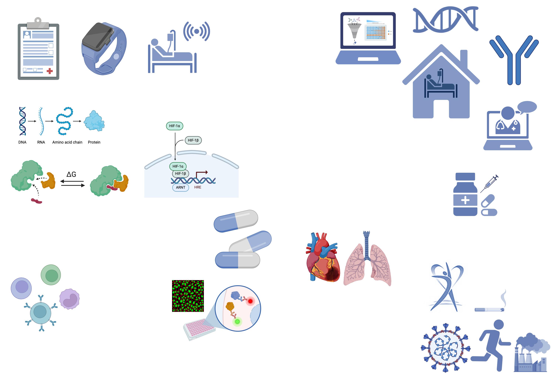
Scope
Biomarker Discovery
Disease Mechanism
Precision medicine
Digital Twin &
Simulation
Mode of Drug Action
&
Diagnostics
Digital Pathology
&
Histology
Novel cell
Population

Slide 7
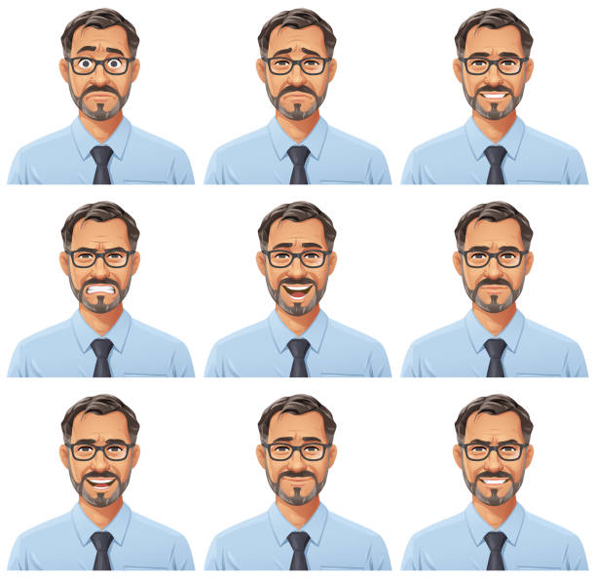
FACING THE UNKNOWN: JOHN'S JOURNEY WITH A BLOOD CANCER
My name is John and I've been diagnosed with a leukemia
Abnormal
Cells

Slide 8
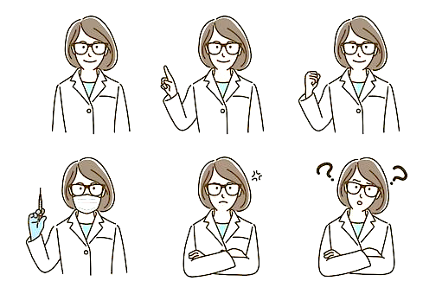
Unfortunately, John's leukemia has relapsed after the first treatment​

Slide 9
How can I determine an effective personalized treatment for John?​

Slide 10

We can help you with our AI solution that stratifies patients

Slide 11
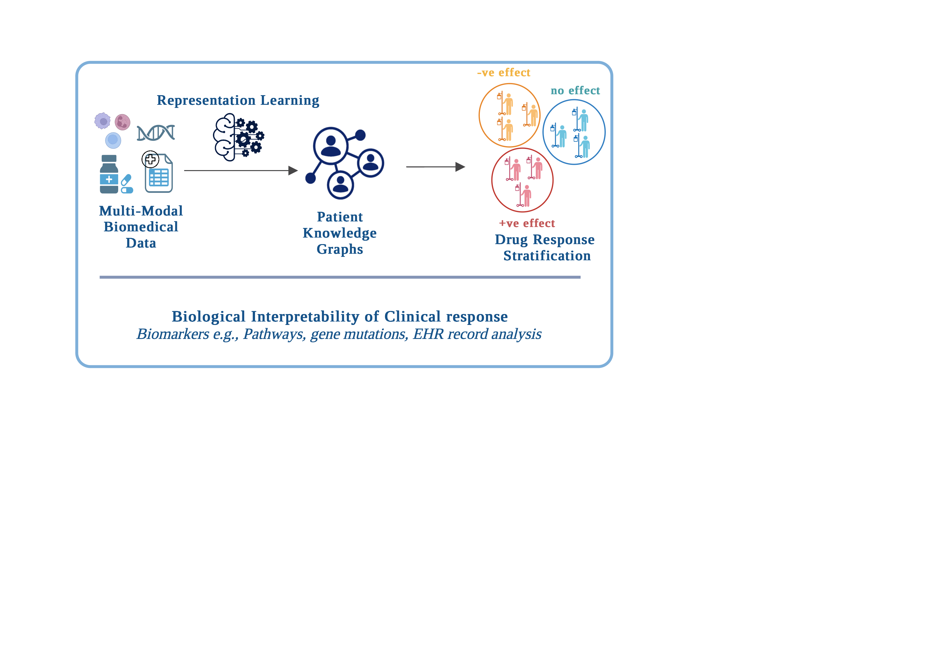


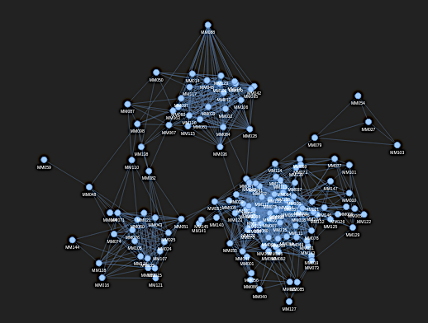

1 - How does John’s data compare to other Leukemia patients ?
MULTI-MODAL DATA
PAIRWISE SIMILARITY
PATIENT SIMILARITY NETWORK
John
Patient 1
Patient 1
<
Patient 2
<
John
Patient 2
$$⋯$$
Patient N
Patient N
John's data is similar to a subset of patients

Slide 12
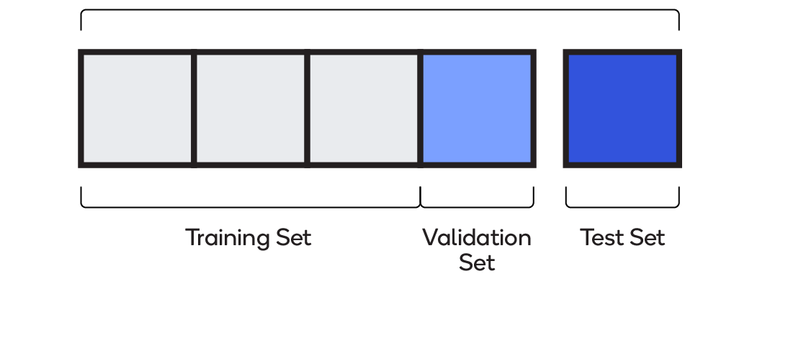
2 – Can John's response to drugs be predicted upfront ?
INPUT
TRAINING AI MODEL
DRUG RESPONSE PREDICTION
Positive Response
No Response
Adverse Effects
Known Response
Unknown

Slide 13



John belongs to a group of patients who respond to a specific subset of drugs
Patients group
Positive Response
John
Drugs
John might respond positively to these drugs

Slide 14
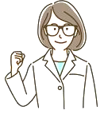
The oncologist prescribed the drug predicted by our AI solution
&
John responded successfully!

Slide 15
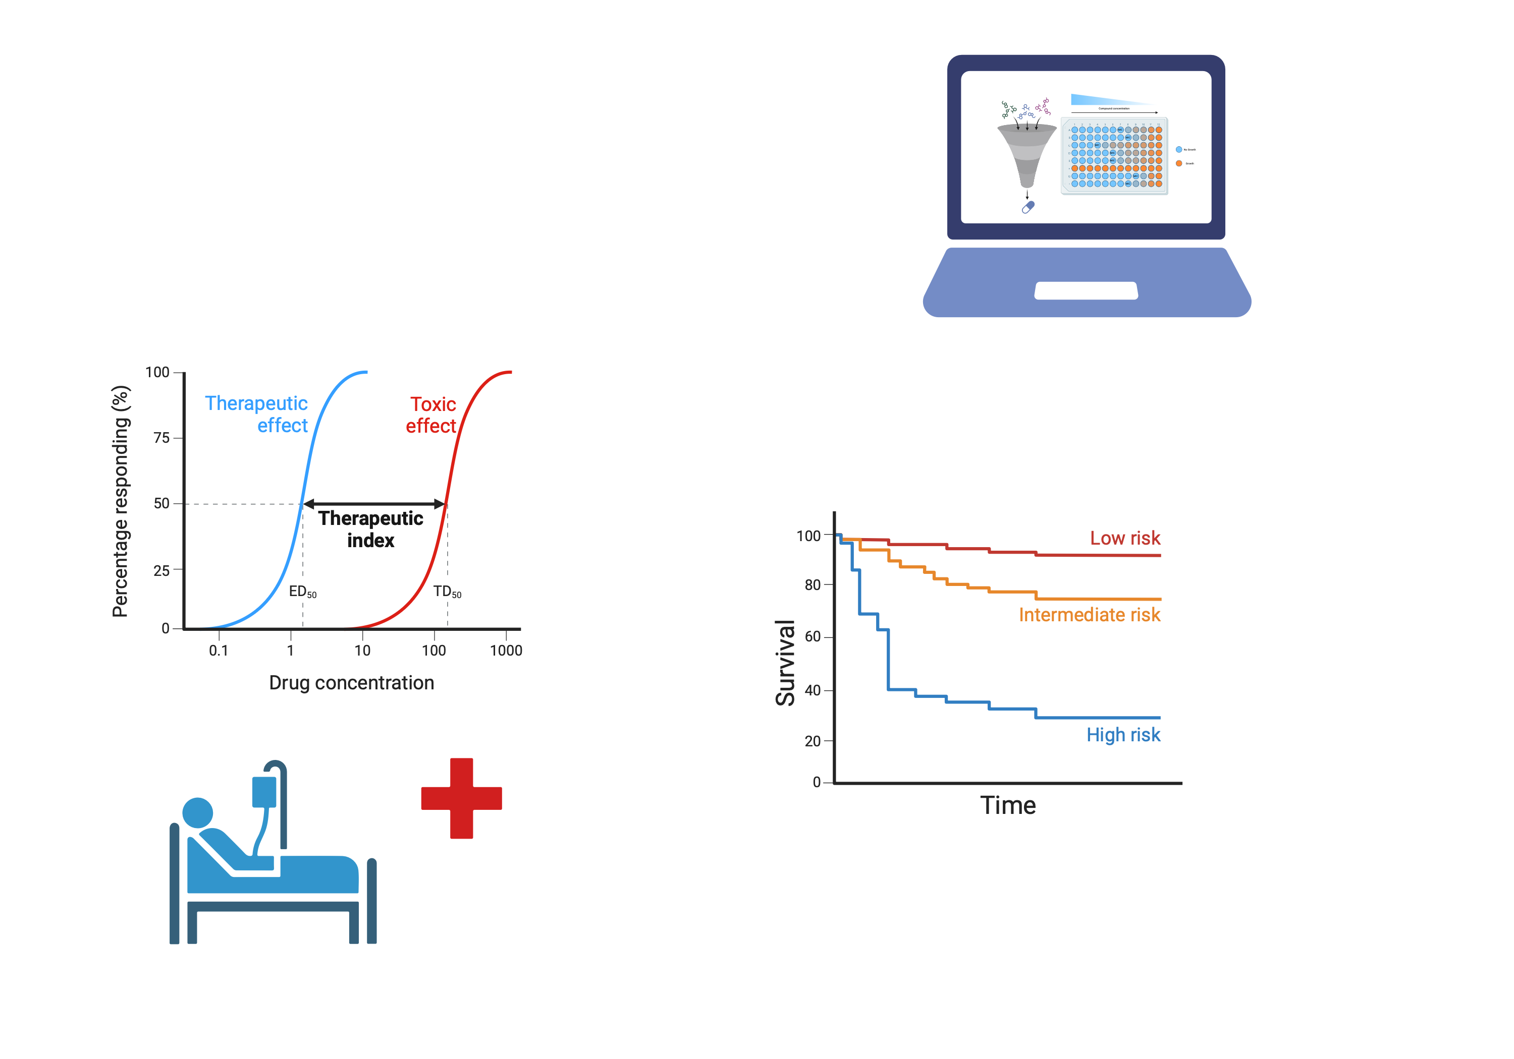

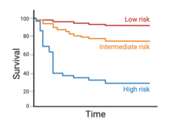

PATH FROM DRY LAB to CLINIC
EXPLORATORY
&
RETROSPECTIVE ANALYSIS
PROSPECTIVE VALIDATION
(CLINICAL COHORTS)
CODE VALIDATION
&
*SaMD REGISTRATION
* Software as a Medical Device

Slide 16


